Slide 1
Citing Your Sources
In Text Citations and Reference Lists
APA Chs. 8 & 9

Slide 2
Introduction
Scientific writing reflects influences from many other researchers
Important to accurately and appropriately acknowledge how others contributed to your work by providing citations
Proper citations are the best way to avoid plagiarism

Slide 3
Why do we cite things?
The “Bold Assertion” Problem
  Example: “Companies are terminating employees at an alarming rate, so they don’t have to pay out retirement plans.”
Says who? What’s the source?
  Without data to back it up, this would not be viewed as a valid point!

Slide 4
How Fix Bold Assertions
Find reputable sources that back up your claims!
  Last week’s discussion on finding research articles???
Use these sources to develop your argument AND give proper credit to your sources
Giving credit requires a citation!

Slide 5
What’s Needed
Two components of a citation:
  In-text citations
    Parenthetical vs. Narrative
  Reference sheet
Important! You need to include both!

Slide 6
APA In-Text Citations
List the author name(s) and publication year
Two types of In-text citations:
  Parenthetical (author, date)
  Narrative (date)
    Author is referenced in the sentence

Slide 7
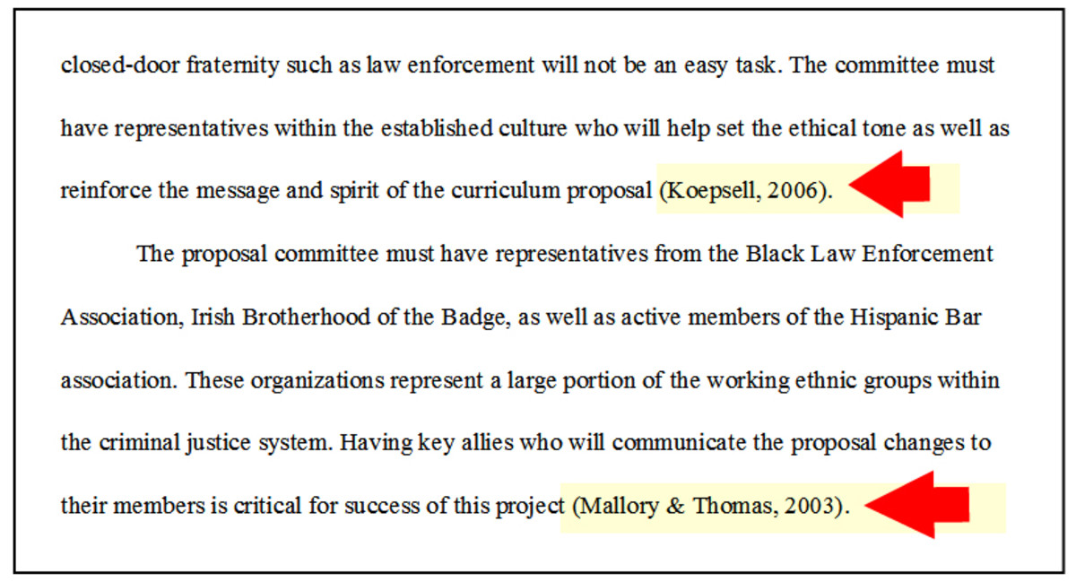
Parenthetical Citation Example

Slide 8
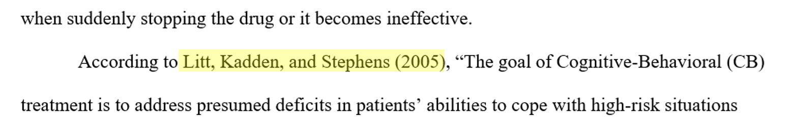
Narrative Citation Example

Slide 9
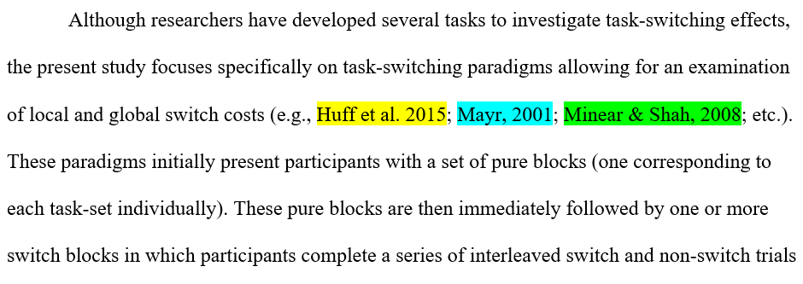
Multiple Cites Example

Slide 10
More than Two Authors in-text
First time: Write out all the authors names (unless it’s a special case with many, many authors)
After that: Replace the trailing authors with “et. al”
Example: (Maxwell, Perry, & Huff, 2022) becomes (Maxwell et al., 2022)
  Note: et al. is plural. Must replace at least two names!

Slide 11
More than Two Authors in-text
APA 7 UPDATE: Use et al. Every time!
Exceptions: When the same first author works with multiple groups and work is published in the same year
  Example1: Maxwell, Huff, Buchanan, & Smith (2020)
    Maxwell et al. (2020)
  Example2: Maxwell, Perry, Huff, & Smith (2020)
    Maxwell et. al. (2020)
Which one is which???

Slide 12
More than Two Authors in-text
APA 7 UPDATE: Use et al. Every time!
Exceptions: When the same first author works with multiple groups and work is published in the same year
  Example1: Maxwell, Huff, Buchanan, & Smith (2020)
    Maxwell, Huff, et al. (2020)
  Example2: Maxwell, Perry, Huff, & Smith (2020)
    Maxwell, Perry, et. al. (2020)

Slide 13
Special Cases
Group Authors: Sometimes a publication is put out by a group or an organization, rather than individual authors
Example: The APA handbook
Cite as (APA, 2020) or APA (2020)

Slide 14
Reference Page
All in-text citations should be listed on the reference page
Ordered alphabetically by last name of lead author
  Multiple works by same author are further alphabetized by second/third/etc. authors
  Further ordered by publication year (earliest to latest)

Slide 15
Reference Page
References need the following information:
  Author name(s)
  Publication year
  Article title (chapter title)
  Journal name (book name)
  Editors (book chapters only)
  Volume/Issue number
  Page number

Slide 16
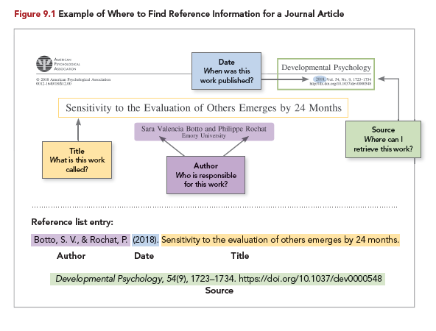

Slide 18
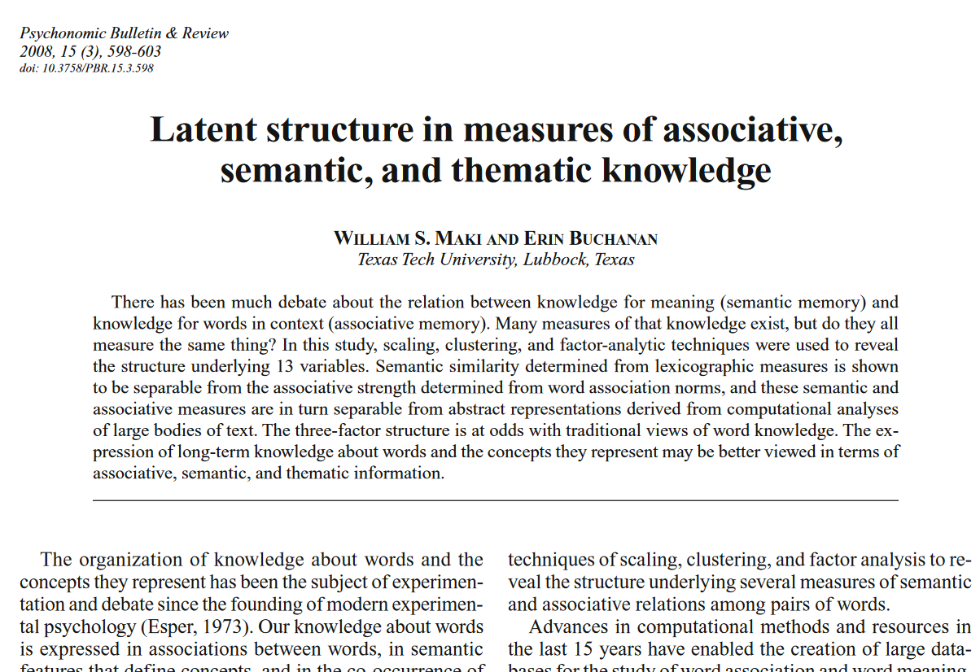
Journal Name

Slide 19
Pub. Year, Volume (Issue), Page Numbers

Slide 20
DOI Number

Slide 21
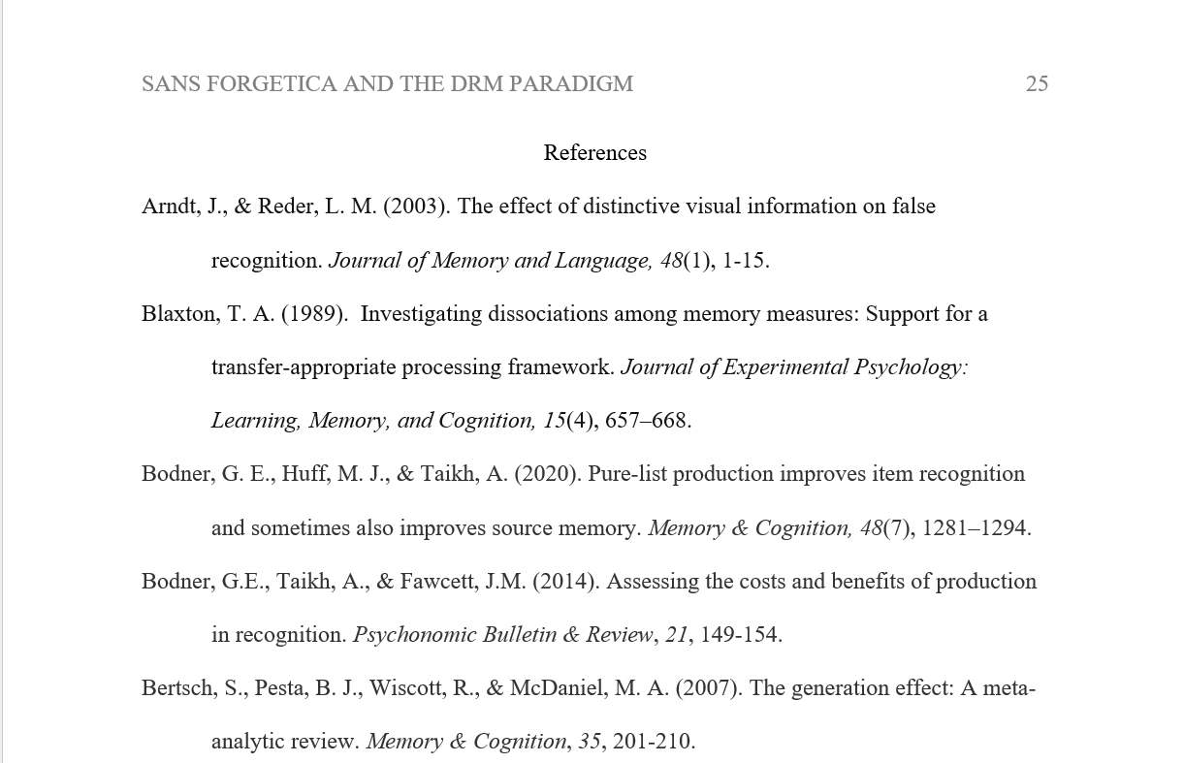

Slide 22
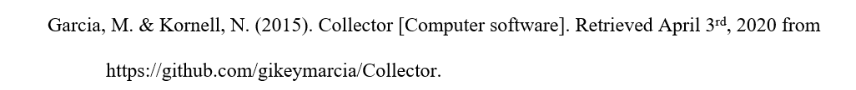
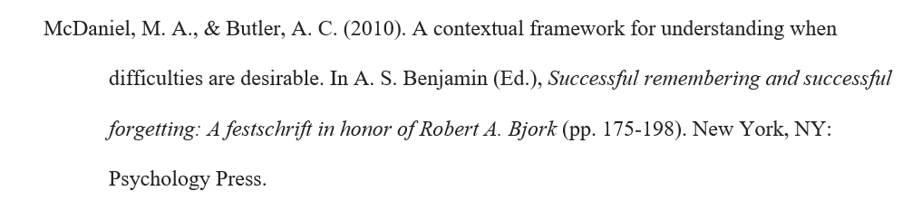
Computer Program Example
Book Chapter Example

Slide 23
Reference Page Formatting Tips
For author names, Last name, Initial
  Nicholas P. Maxwell → Maxwell, N. P.
Separate authors with commas, ampersand (&) before last author
  Nicholas P. Maxwell and Erin M. Buchanan → Maxwell, N. P., & Buchanan, E. M.

Slide 24
Reference Page Formatting Tips
Journal article titles:
  Capitalize first word.
    Investigating the effects of cheese on memory
  Capitalize first word after colons or question marks
    How does cheese effect memory? A study using rodents
Journal names:
  Capitalized and italicized
    Memory & Cognition; Journal of Clinical Psychology; etc.

Slide 25
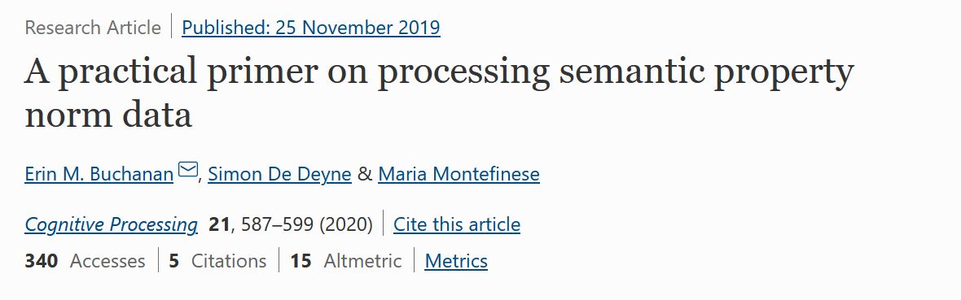
Practice
Buchanan, E. M., De Deyne, S., & Montefinese, M. (2020). A practical primer on processing semantic property norm data. Cognitive Processing, 21, 587-599.

Slide 26
What Should you Cite?
Did it directly influence your work?
  If yes, you need to cite it!
Types of influence:
  Background information
  Support/disputes your research question
  Provides clarity or defines terms

Slide 27
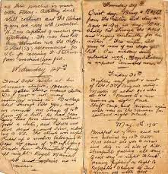
Primary vs. Secondary Sources
Primary sources
  Immediate, first-hand accounts of topic
  Author has a direct connection to the material
  Examples:
    Speeches, diaries, letters, or interviews
    Text of laws or other original historical documents
    Original research findings

Slide 28

Primary vs. Secondary Sources
Secondary Sources
  One step-removed from primary sources
  Second-hand accounts of evens (often quote primary sources)
  Add a layer of analysis or interpretation
  Examples:
    Books on a topic
    Documentaries
    Review papers

Slide 29
Primary vs. Secondary Sources
So which should you use?
Rely primary sources first
According to the APA:
  “find the primary source, read it, and cite it directly rather than citing a secondary source” (APA version 7, page 258)
Try to find the original when possible

Slide 30
Appropriate Level of Citation
You should cite when a work directly influences your writing, but what does that mean?
You should cite whenever:
  You paraphrase (rephrase in your own words) someone else’s ideas
  Directly quote another author
  Reference data patterns or findings
  Recreate a table or figure
  Refer to an instrument (e.g., questionnaire, test, computer program, etc.

Slide 31
Paraphrasing
Paraphrase == restate another’s idea in your own words
Summarize and synthesize
Must be cited! (parenthetical or narrative)
Paraphrasing may be long. Only cite once (no need to cite after every sentence)

Slide 32
Paraphrasing
Paraphrase == restate another’s idea in your own words
Summarize and synthesize
Must be cited! (parenthetical or narrative)
Paraphrasing may be long. Only cite once (no need to cite after every sentence)

Slide 33
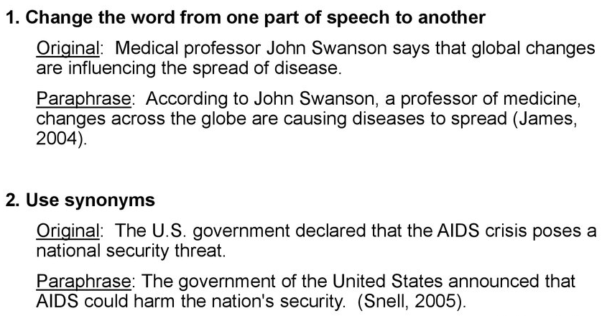
Paraphrasing Tips

Slide 34
Paraphrasing Practice (1)
Of the more than 1000 bicycling deaths each year, three-fourths are caused by head injuries. Half of those killed are school-age children. One study concluded that wearing a bike helmet can reduce the risk of head injury by 85 percent. In an accident, a bike helmet absorbs the shock and cushions the head. From "Bike Helmets: Unused Lifesavers," Consumer Reports (May 1990): 348.

Slide 35
Paraphrasing Practice (2)
While the Sears Tower is arguably the greatest achievement in skyscraper engineering so far, it's unlikely that architects and engineers have abandoned the quest for the world's tallest building. The question is: Just how high can a building go? Structural engineer William LeMessurier has designed a skyscraper nearly one-half mile high, twice as tall as the Sears Tower. And architect Robert Sobel claims that existing technology could produce a 500-story building. From Ron Bachman, "Reaching for the Sky." Dial (May 1990): 15.

Slide 36
Direct Quotation
Reproduces words from another work verbatim
Two types:
  Short Quotes
  Block Quotes (long)

Slide 37
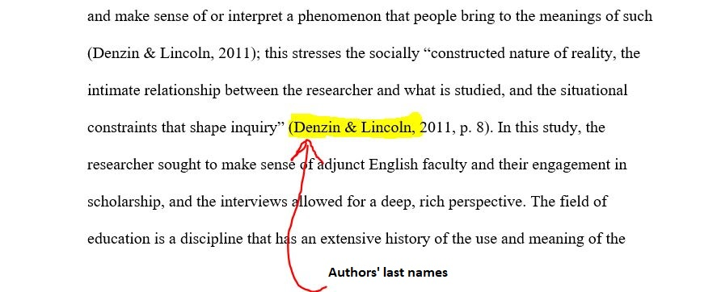
Short Quotes
Rule of thumb:
  Less than 40 words
These are incorporated into the text, in double quotation marks

Slide 38
Block Quotes
Longer than 40 words? Use a block quote
Indented 0.5 inches (one tab)
Do NOT use quotation marks
Cite at end (parenthetical) or in text leading to quote (narrative)

Slide 39
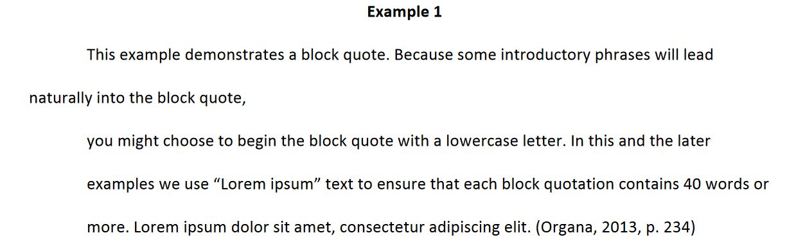
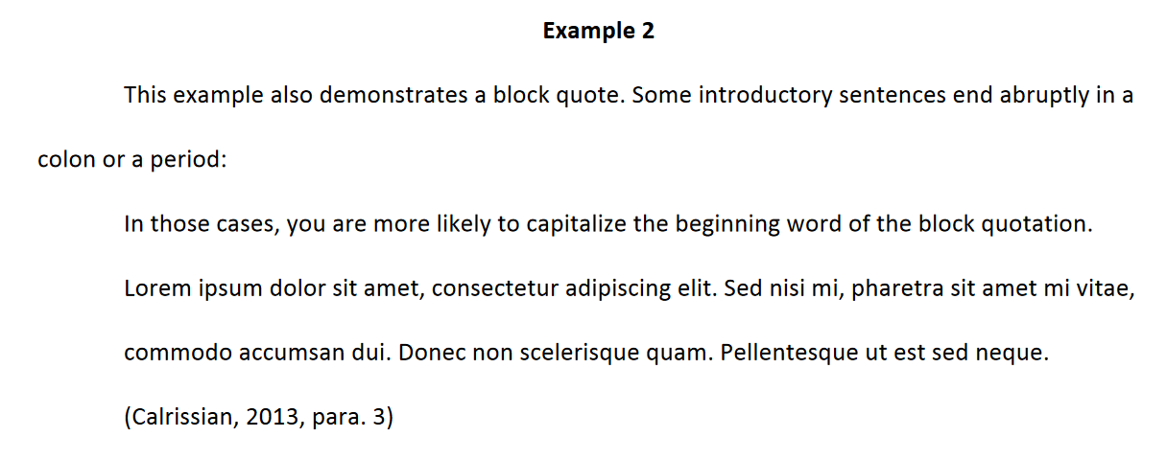

Slide 40
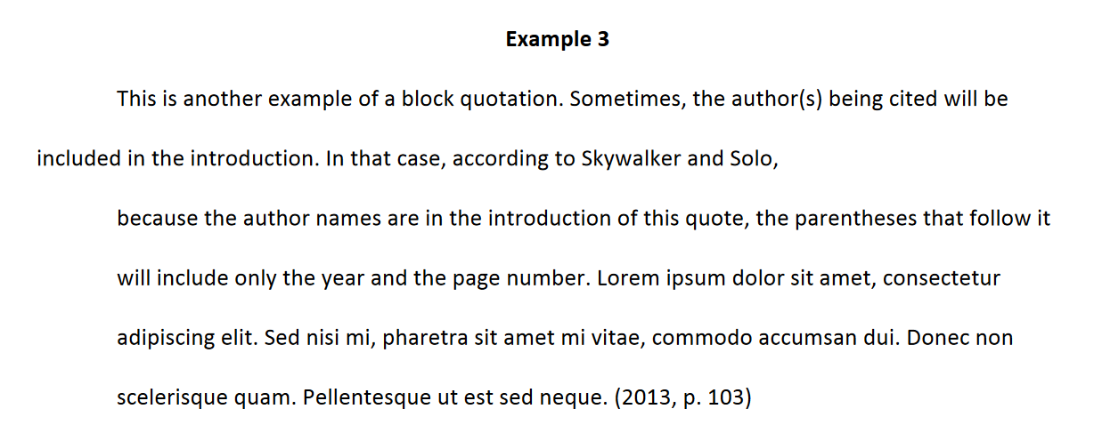

Slide 41
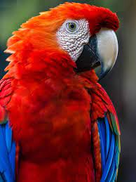
Paraphrasing vs. Direct Quotes
Use direct quotes sparingly
Paraphrase when possible.
  Its better to summarize your own point and provide a citation to back up your claim than to parrot another author.

Slide 42
Signal and Lead-in Phrases
Different ways to introduce quotes, paraphrases, etc.
Variety is important!
Example:
  According to Smith, …. [paraphrase]
  As argued by Smith,….
  However, recent work by Smith suggests that…

Slide 43
Why does Citing Matter?
Gives proper credit to the original authors
Other’s who read your work can locate your sources
Avoids plagiarism!

Slide 44
Plagiarism
Presenting words, ideas, or images of another as your own
Can be deliberate or unintentional
At its worst, deliberate plagiarism is cheating
  Don’t do it.
  Also don’t do it.

Slide 45
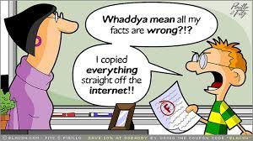
Plagiarism
Why is this an issue?
  Denies authors the credit they are due
  Disrespectful, unfair to those who did the original work

Slide 46
Examples
Turning in someone else's work as your own
Copying words or ideas from someone else
without giving credit (like straight of Wikipedia)
Giving incorrect information about the source of
a quotation
Changing words but copying the sentence
structure of a source without giving credit
Majority of your work comes from another source, whether you give credit or not

Slide 47
Plagiarism
What happens if you deliberately plagiarize?
As a professional:
  Rejection from publication
  Denied tenure (faculty)
  Employment consequences

Slide 48
Plagiarism
What happens if you deliberately plagiarize?
As a student:
  F on assignment, Failed class, or Expulsion (extreme cases)

Slide 49
Self-Plagiarism (yes that’s a thing)
Presentation of your own previously published material as something new or original
For students:
  Submitting the same paper in multiple classes

Slide 50
Helpful Resources
https://www.citationmachine.net/apa
https://apastyle.apa.org/style-grammar-guidelines/citations
https://owl.purdue.edu/owl/research_and_citation/apa_style/apa_formatting_and_style_guide/general_apa_faqs.html

Slide 51
Reminder! Bibliography and Article Summaries
Due in class 9/20!
Find 10 sources
What’s expected?
  Create a reference entry (more on that next week)
  Briefly summarize each source (150 – 300 words per source)
    What is the author’s main point? What did they find and what are the implications? How does this source apply to your research question?
Resources:
  https://libguides.umgc.edu/annotated-bibliography-apa

Slide 52
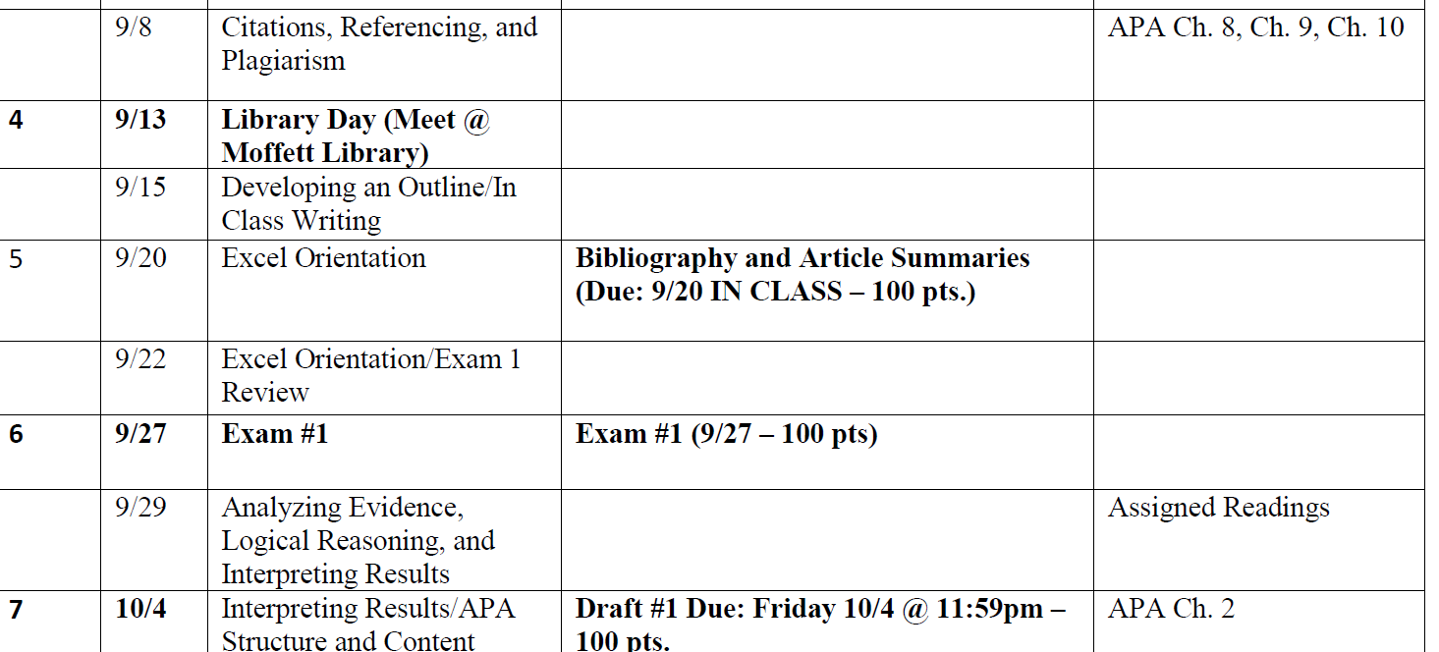
Other Important Junk

Slide 53
Other Important Junk

Slide 54
Other Important Junk

